Slide 1
Programming in Python: sequence
Lesson 6: Working with strings

Slide 2
Objectives
In this lesson, you will learn how to:
use index values to identify individual characters in a string
slice a string to select a section of it
join strings together using concatenation
change the case of a string to upper or lower case
calculate the length of a string.

Slide 3
What is a string?
A string is an ordered list of characters.
'Hello', '%^$&*' and '12345' are all strings.

Slide 4
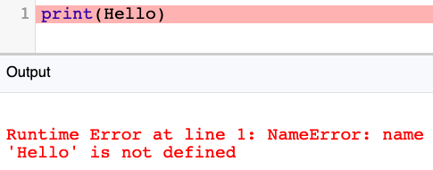
How do we know a bit of code is a string and not, for example, the name of a variable?
A string must be inside quotation marks:
If we don’t use quotation marks, Python thinks the string is a variable:
1 print(Hello)
Output
Runtime Error at line 1: NameError: name 'Hello' is not defined

Slide 5

Activity 6.1: Programming in Python: sequence, Section 6

Slide 6
Questions
You have been learning about strings. Look at this code:
What would be the output if the following line of code was added to the program and the program was run?
print(len(text))
print(text.upper())
print(text[7] + text[4] + text[3])
print(text[1:4])

Slide 7
Programming constructs
There are three fundamental programming constructs.
Sequence
Selection
Iteration
In this module, all the programs you have written were sequential. The instructions were carried out in order, from top to bottom.

Slide 8
Quiz 6

